Slide 1
Classification of Highly Interacting Regions of the Genome with Explainable AI
GROUP NO: 36
Shreya Pawaskar - 4947
Radhika Sethi - 4456
Aanchal Tulsiani - 4964
External Guide: Dr. Leelavati Narlikar
Internal Guide: Mrs. Pranjali Deshpande
Mentor: Miss. Anushua Biswas
Notes:
Only title - prob statement on the next slide , agenda on the next
Ext guide, internal

Slide 2


Road Map
Problem Statement
Deep Learning Review
Current Paper Implementation
Results
Future Work
Conclusion
References
Notes:
Intro-probolem stm - motivation -

Slide 3
Problem Statement
Our Problem Statement is as follows:
“To identify the regions governing gene regulation and classify them as highly interacting and non-interacting regions”
The Objectives being covered are :
Learn how to model biological sequencing and DNA data. Understand their underlying properties and how to find patterns in them
Efficiently use deep learning algorithms to distinguish TADs and their boundaries.
Classify genomic sequences as potentially interacting regions or non-interacting regions
Find which traits of TADs in these regions make them more interactive.
Understand how these specific regions influence gene regulation.
Find genomic sequence properties which influence the transformation of a cell into a diseased cell.

Slide 4
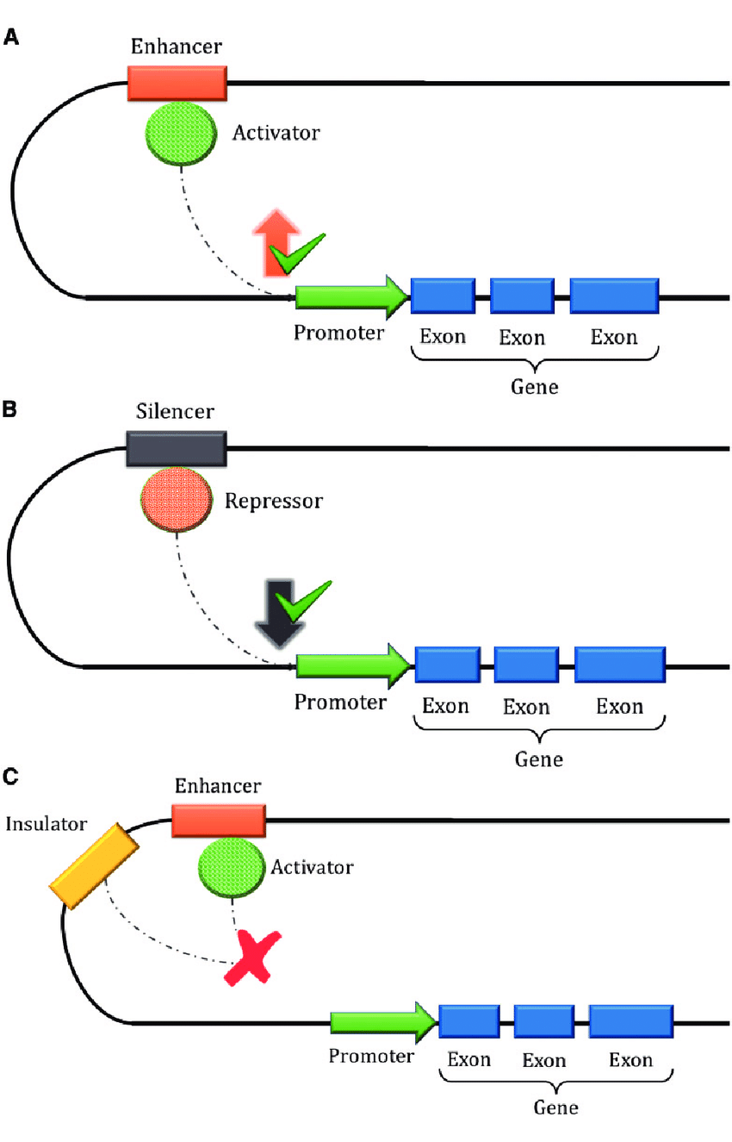
Current paper implementation
Paper: Enhancer–silencer transitions in the human genome
Enhancers are short motifs that contain binding sites for transcription factors
A sequence that causes a decrease in gene activity is called a silencer
Multiclass convolutional neural network (CNN) model with three nodes in the output layer representing silencers, enhancers, and regulatory neutral DNA sequences
Link: https://genome.cshlp.org/content/early/2022/02/01/gr.275992.121.full.pdf

Slide 5
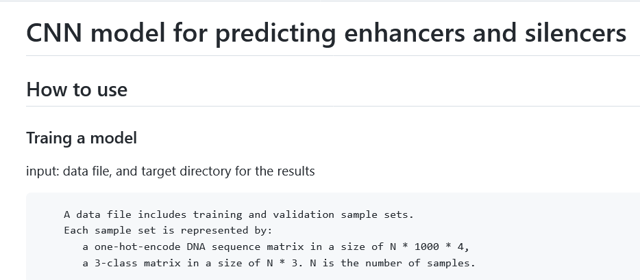
Current paper implementation

Slide 6
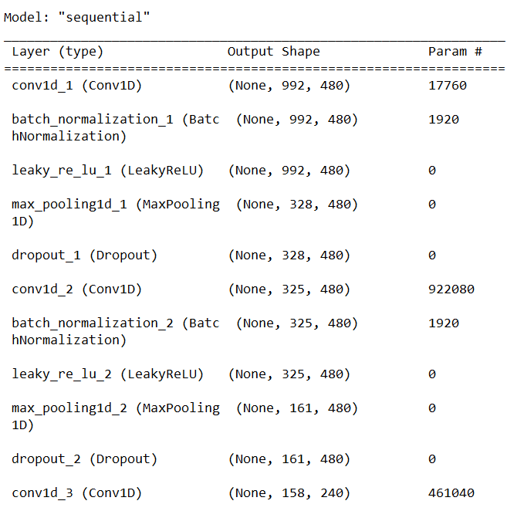
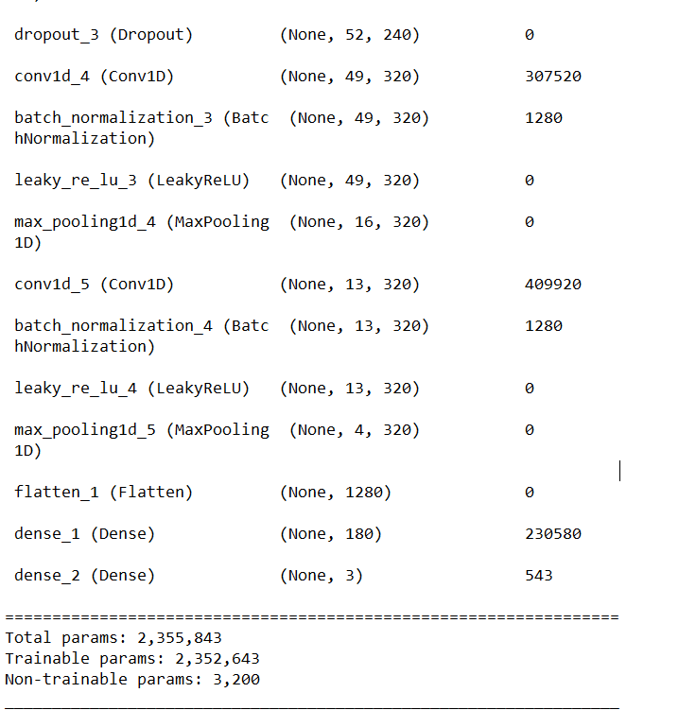
Paper’s CNN Model Architecture

Slide 7
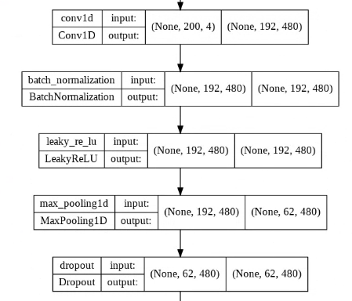
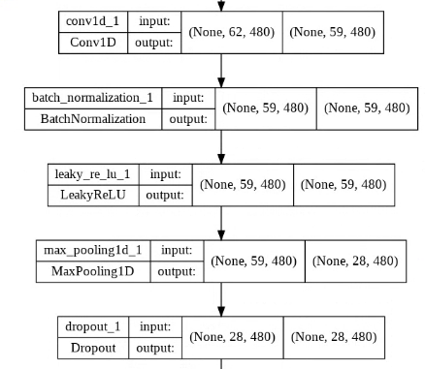
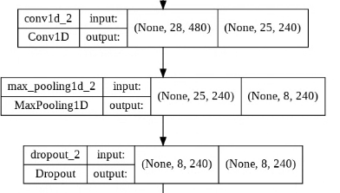
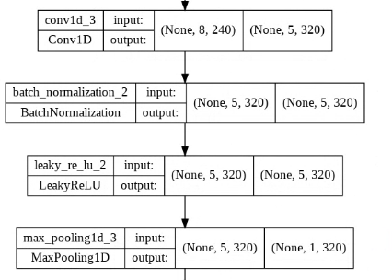
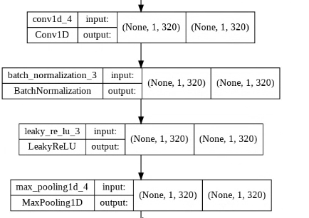
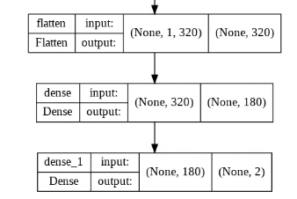
Our modified Model Architecture

Slide 8
Results
Model | Val Acc | Test Acc | Trainable parameters | Layers Deleted
Original | 0.59 | 0.65 | 1,872,462
None

Slide 9
Results
Model | Val Acc | Test Acc | Trainable parameters | Layers Deleted
1 layer reduction (removed 4th set) | 0.6925 | 0.80 | 1,653,902

Slide 10
Results
Model | Val Acc | Test Acc | Trainable parameters | Layers Deleted
2 layers reduction (removed 3rd and 4th set) | 0.7077 | 0.7975 | 1,675,422

Slide 11
Results
Model | Val Acc | Test Acc | Trainable parameters | Layers Deleted
3 layers reduction (removed 3rd, 4th and 5th set) | 0.5027 | 0.5563 | 5,376,062

Slide 12
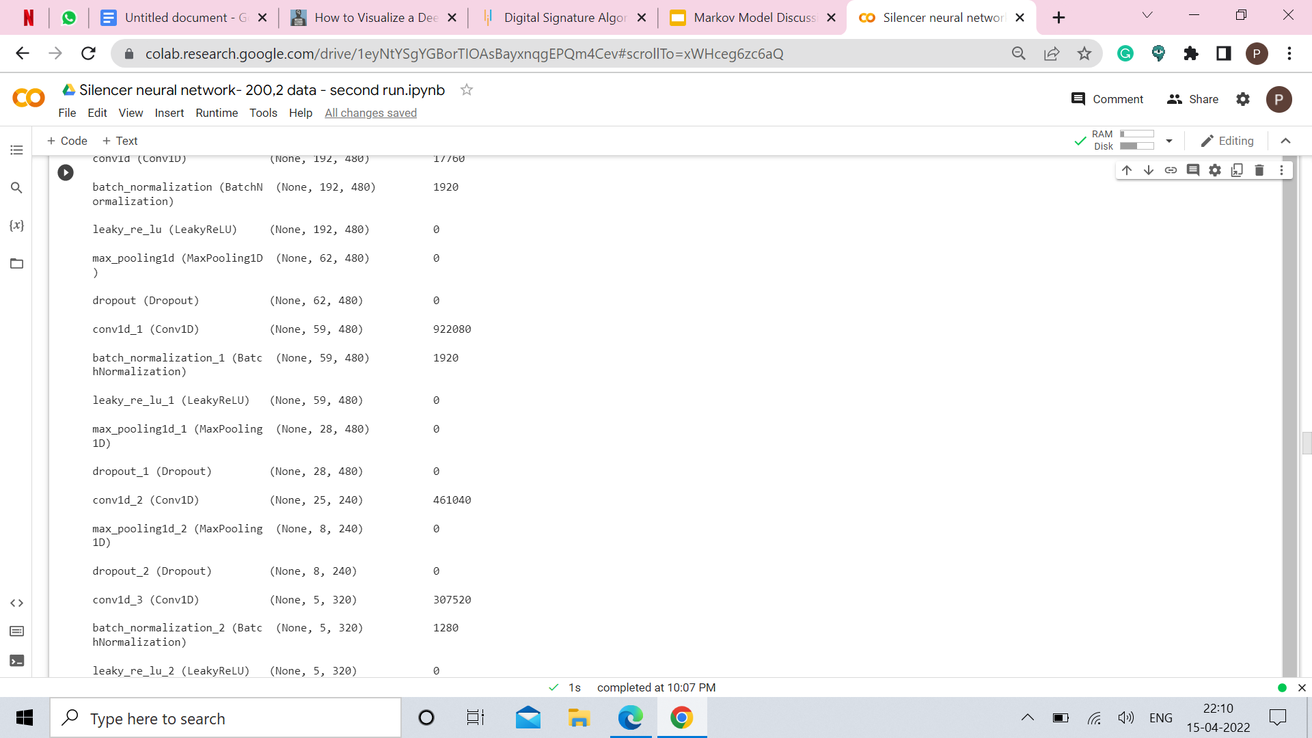
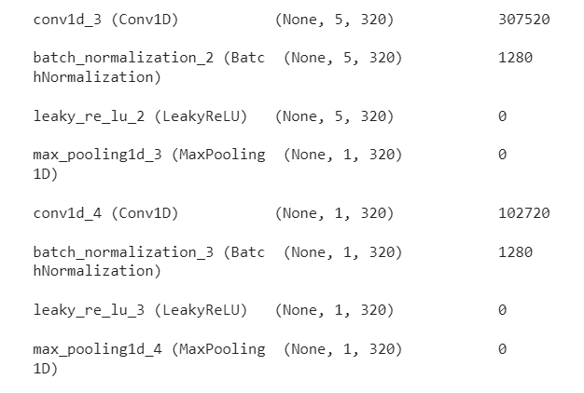
Results
Model | Val Acc | Test Acc | Trainable parameters | Layers Deleted
3 layer reduction (removed the 2nd, 4th and 5th set) | 0.50 | 0.50 | 1301102

Slide 13
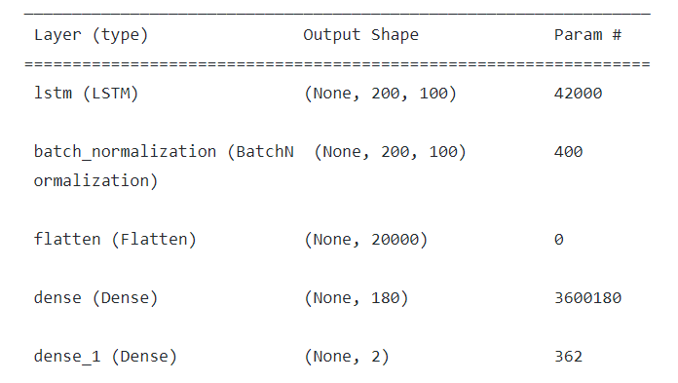
Results
Model | Val Acc | Test Acc | Trainable parameters | Model Architecture
LSTM | 0.56 | 0.56 | 3,642,742

Slide 14
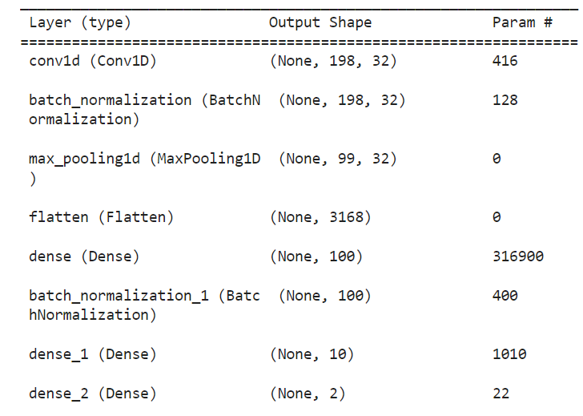
Results
Model | Val Acc | Test Acc | Trainable parameters | Model Architecture
MNIST | 0.55 | 0.54 | 318,612

Slide 15
Future Work
We need to work on better CNN architectures that will be able to classify the genome sequences into highly interacting and non interacting regions
The next step is to uncover and understand what features in these genome sequences actually make the deep learning model classify them into their respective classes
To understand this further we will be working with explainable AI architectures to uncover how these specific regions influence gene regulation.
Benchmarking the current approach on drosophila and try transfer learning methods

Slide 16
References
https://genome.cshlp.org/content/early/2022/02/01/gr.275992.121.full.pdf
https://genome.cshlp.org/content/32/3/437.full
https://link.springer.com/article/10.1007/s12539-021-00453-4
https://en.wikipedia.org/wiki/Topologically_associating_domain
https://www.ncbi.nlm.nih.gov/pmc/articles/PMC8142020/
https://pubmed.ncbi.nlm.nih.gov/29654311/
https://www.biorxiv.org/content/10.1101/2020.09.03.282186v3
https://www.ncbi.nlm.nih.gov/pmc/articles/PMC4838359/
https://www.nature.com/articles/nature11082
https://arxiv.org/abs/1605.01133v2
https://github.com/QData/DeepMotif
https://paperswithcode.com/paper/deep-motif-visualizing-genomic-sequence
https://academic.oup.com/nar/article-lookup/doi/10.1093/nar/gkaa530#supplementary-data
https://www.nature.com/articles/s41467-017-02526-9

Slide 17
Thank you !

